Slide 1
Atomic model
Nick Katachin
MYP 4.2

Slide 2
Atom
An atom is the smallest unit of ordinary matter that forms a chemical element. Every solid, liquid, gas, and plasma is composed of neutral or ionized atoms. Atoms are extremely small, typically around 100 picometers across. They are so small that accurately predicting their behavior using classical physics—as if they were tennis balls, for example—is not possible due to quantum effects.

Slide 3
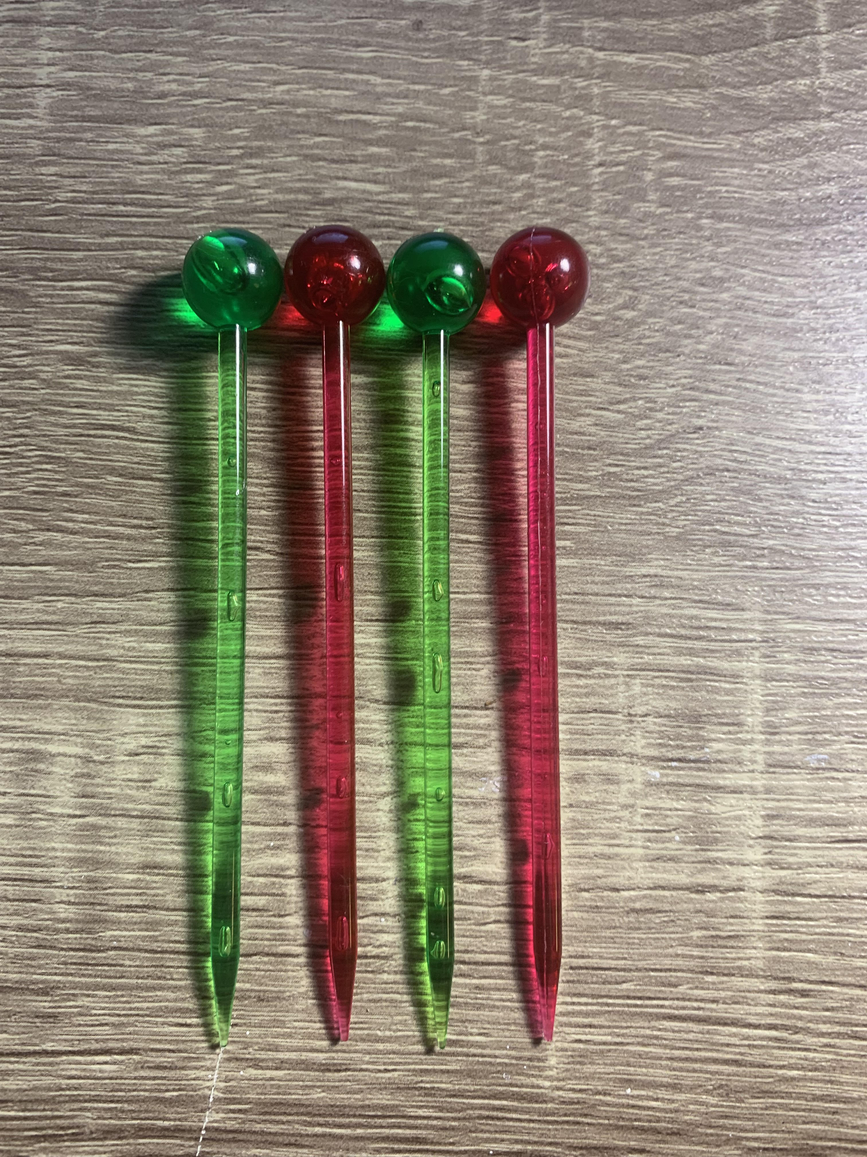
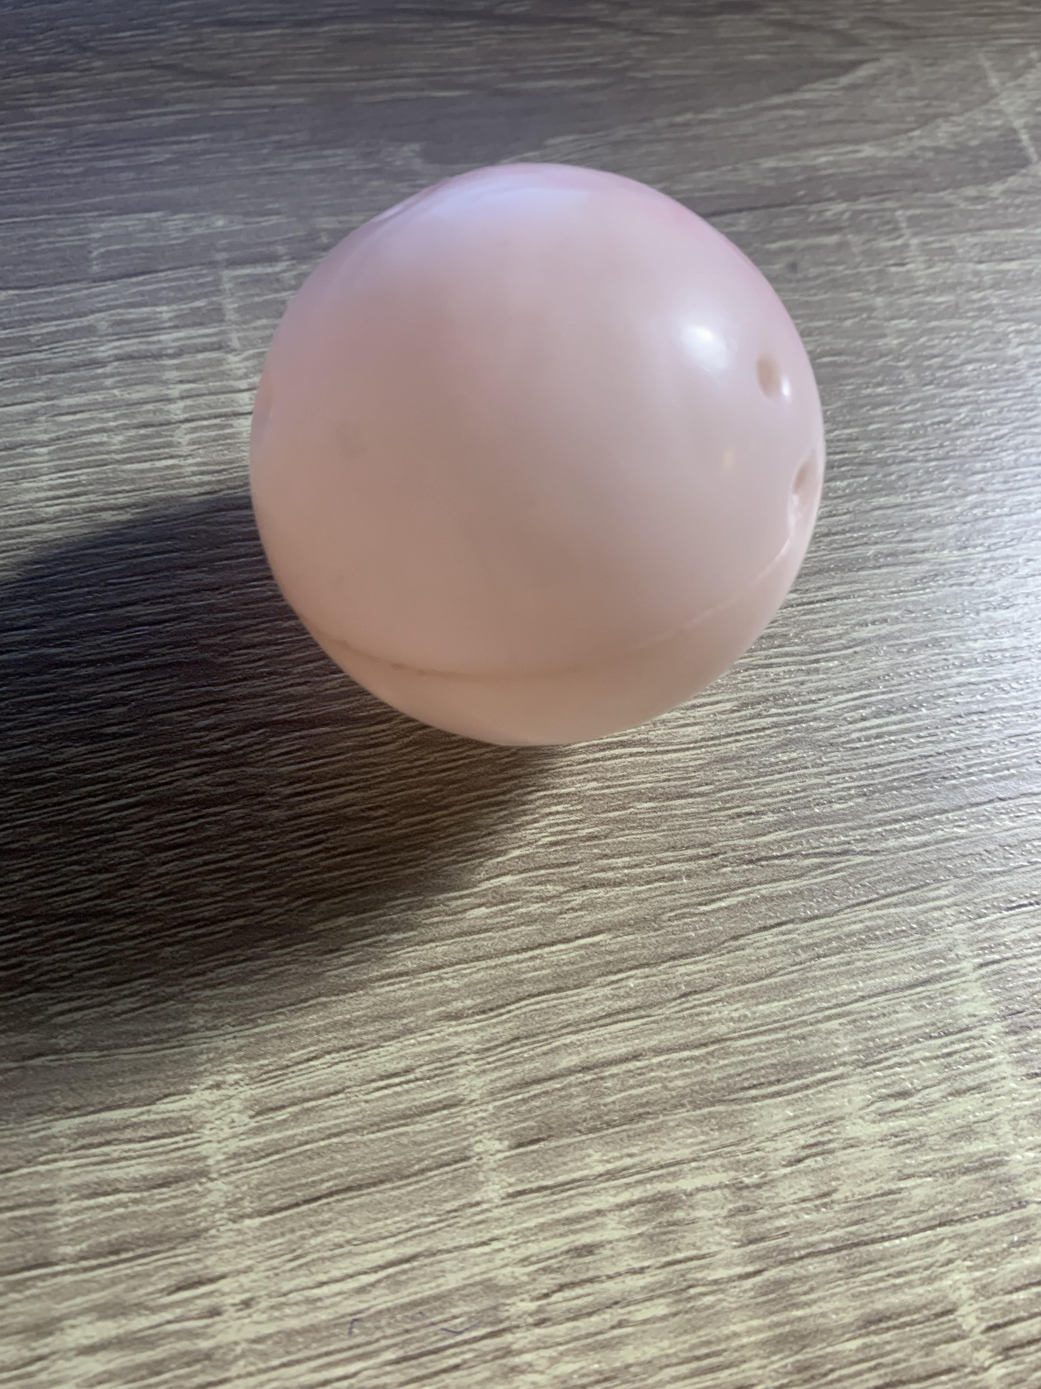
I choose this ingredients because in my opinion Plastic ball is like a big atom and cocktail sticks like electrons We need just connect sticks with plastic ball
Ingredients:
Cocktail stick
Pink plastic ball

Slide 4
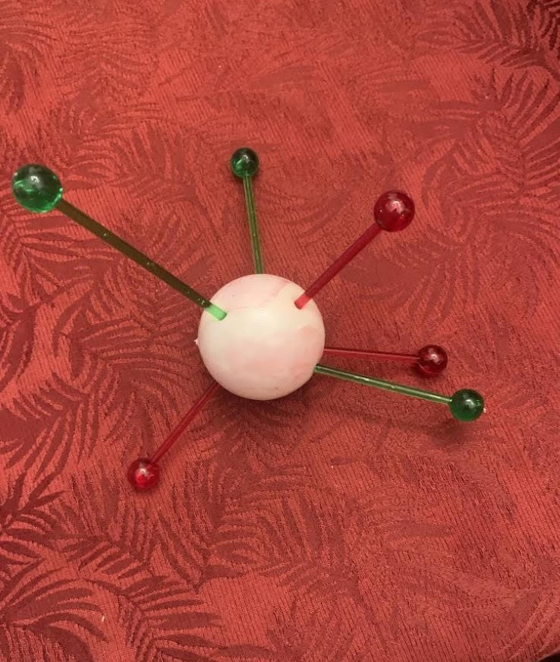
What about inaccuracy in our atomic model .Of course we can not make model without inaccuracies because every part of an atom moves. That means that distance between parts of an atom always changes by itself

Slide 5
calculations
The distance between a neutron and a proton was presumed to be 2
The distance between a proton and an electron about 0.05
The distance between a neutron and an electron about 0.06

Slide 6
Sizes
Sizes of parts of a model is:
Size of proton - 0.84–0.87 fm
Size of neutron - about 0.8×10^−15 m
Size of electron - 2.8179×10^−15 m

Slide 7
Protons, neutrons and electrons don’t have same size and distance
They can’t have one size because the mass of a neutron is greater than the mass of proton, which means that size bigger too, and electrons is very small.
Distance between protons, neutrons and electrons aren’t the same again because they move a lot.

Slide 8
Thank you for attention

